Slide 1

News AI: AI-Powered News Categorization, Summarization,
and Multilingual Recommendation System
DSA0305- Natural Language Processing
PRSENTED BY:
Bhavana Allaparthi [192472141]
Pasyavula Gayathri [192424324]
Cherukuri Likhitha [192424239]
C Prathibha [192424293]
A Roja [192424226]
GUIDED BY:
Dr K ANBAZHAGAN

Slide 2


OVERVIEW
Overview
Abstract
Introduction
Literature Review
Existing System
Problem Identification
Objectives
Proposed System
Architecture Diagram
Algorithms
Module 1 – News Data Collection & Preprocessing
Module 2 – AI-Based News Categorization
Module 3 – AI News Summarization
Module 4 – Multilingual Translation
Module 5 – Personalized Recommendation
Coding & Output
Results and Discussion
Conclusion
Future Enhancement
References

Slide 3
ABSTRACT
News AI is an intelligent news processing and recommendation system designed to help users consume digital news efficiently.
The system uses Artificial Intelligence and Natural Language Processing (NLP) to automatically collect news, categorize articles, generate concise summaries, translate content into multiple languages, and recommend relevant news based on user interests.
The proposed system reduces information overload and reading time while providing users with personalized, summarized, categorized, and multilingual news through a single platform.

Slide 4
INTRODUCTION
The growth of digital media has resulted in a huge amount of news being published every day.
Users often find it difficult to identify relevant and trustworthy information.
Reading complete articles requires considerable time.
Language barriers make news inaccessible to users who prefer regional languages.
Traditional news platforms provide limited personalization.
News AI combines NLP, Machine Learning, translation, summarization, and recommendation techniques.
The main objective is to provide users with relevant news in a faster and easier manner.
02

Slide 5
LITERATURE REVIEW
S.No | Author(s) | Year | Research Work | Key Contribution
1 | Aishwarya Mirashi et al. | 2024 | Indic News Classification | Multilingual news classification for 10 Indian languages.
2 | Abhinaba Bala et al. | 2024 | Mizo News Summarization | Developed a method for summarizing Mizo news articles.
3 | K. M. Rani Krishna et al. | 2025 | News Text Summarization | Evaluated deep-learning models for automatic news summarization.
4 | Manish Motghare et al. | 2025 | Indian English NewsSumm | Created a large Indian English news summarization dataset.

Slide 6
EXISTING SYSTEM
Traditional news websites mainly provide article browsing.
Users have to manually search for topics of interest.
Full articles need to be read to understand important information.
News categorization may be limited.
Summarization and translation may require separate applications
Recommendations are often generic rather than personalized.
Users may receive large amounts of irrelevant information.
Limitations
Information overload
Time-consuming reading
Limited personalization
Language barriers
Repetitive content
Multiple tools required

Slide 7
PROBLEM STATEMENT
Major Problems
1. Information Overload: Large numbers of news articles make it difficult to find important information.
2. Long Articles: Reading complete news articles takes a lot of time.
3. Categorization Problem: Manually classifying a large number of news articles is difficult and time-consuming.
4. Language Barrier: Users may not understand news available in different languages.
5. Lack of Personalization: General news feeds may not match the individual interests of users.
6. Repetitive Content: Users may receive the same or similar news from different sources.
03

Slide 8
OBJECTIVES
Collect and preprocess news articles automatically
Translate news into multiple languages
1
4
Classify news articles into appropriate categories using AI
Recommend relevant news based on user interests and behavior
2
5
Generate concise summaries from lengthy news articles
Provide an integrated, user-friendly intelligent news platform
3
6
04

Slide 9
PROPOSED SYSTEM
The proposed News AI system provides an integrated AI-based news processing pipeline.
The system will:
Collect news articles from news sources/APIs.
Clean and preprocess the collected data.
Automatically classify news into categories.
Generate short summaries using AI.
Translate news into the user's preferred language.
Analyze user interests and reading behavior.
Recommend relevant news articles.
Display personalized news through a user-friendly interface.

Slide 10
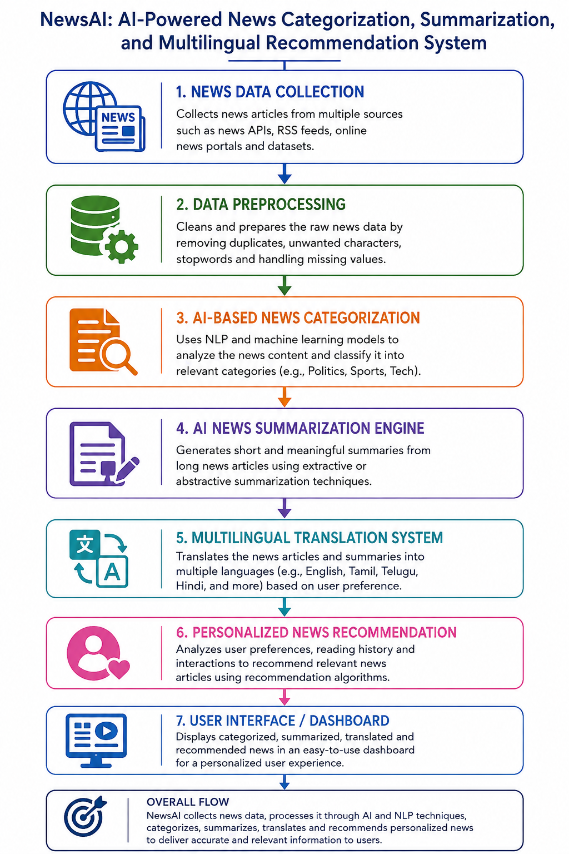
SYSTEM ARCHITECTURE
NEWS SOURCES
06

Slide 11
ALGORITHMS
TF-IDF – Converts news articles into numerical text features.
Support Vector Machine (SVM) – Categorizes news into different topics.
TextRank – Extracts important sentences for news summarization.
XLM-R (XLM-RoBERTa) – Processes and understands multilingual news content.
Cosine Similarity – Finds similar articles and supports personalized news recommendations.

Slide 12
MODULE 1
News Data Collection & Preprocessing
FUNCTIONS
PURPOSE
1
Collects news articles from datasets, APIs, RSS feeds, or online sources
To collect news from different sources and prepare clean, structured text for further AI processing.
2
Removes duplicate news articles and unnecessary data
3
Cleans HTML tags, special characters, URLs, and unwanted text
4
Performs tokenization and text normalization
5
Removes unnecessary stop words and textual noise
6
Converts cleaned news into a format suitable for AI models
07

Slide 13
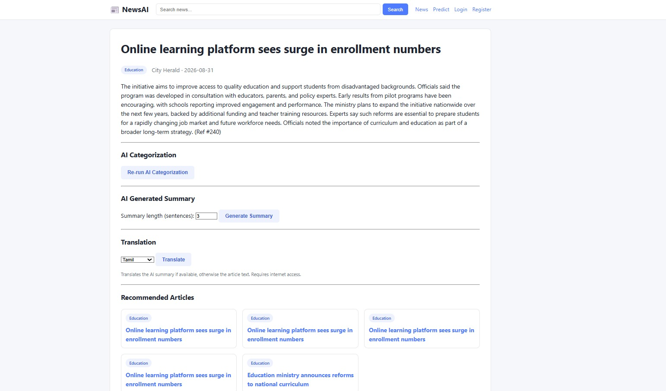
OUTPUT

Slide 14
MODULE 2
AI-Based News Categorization
FUNCTIONS
1
Receives cleaned news articles from the preprocessing module
PURPOSE
To automatically classify news articles into appropriate categories using AI and NLP.
Extracts important features and information from the news text
2
3
Converts text into numerical representations for model processing
4
Applies a Machine Learning or Deep Learning classification model
5
Assigns categories such as Sports, Politics, Technology, Business, Entertainment
6
Sends the categorized news to the next processing stage
08

Slide 15
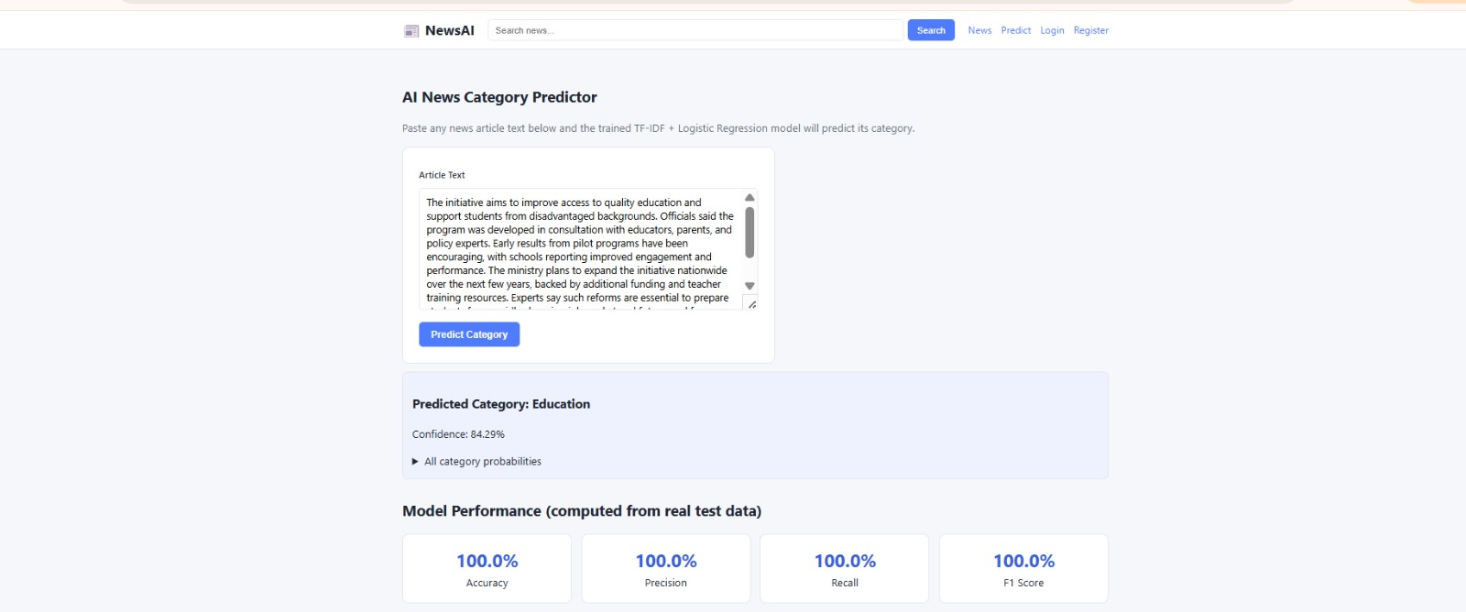
OUTPUT

Slide 16
MODULE 3
AI News Summarization Engine
FUNCTIONS
1
Accepts the complete news article as input
PURPOSE
To generate a short and meaningful summary from lengthy news articles while retaining important information.
Analyzes the article using NLP techniques
2
3
Identifies important facts, events, and key information
4
Selects or generates the most relevant content for the summary
5
Produces a concise summary using extractive or abstractive methods
6
Displays the generated summary to help users understand news quickly
09

Slide 17
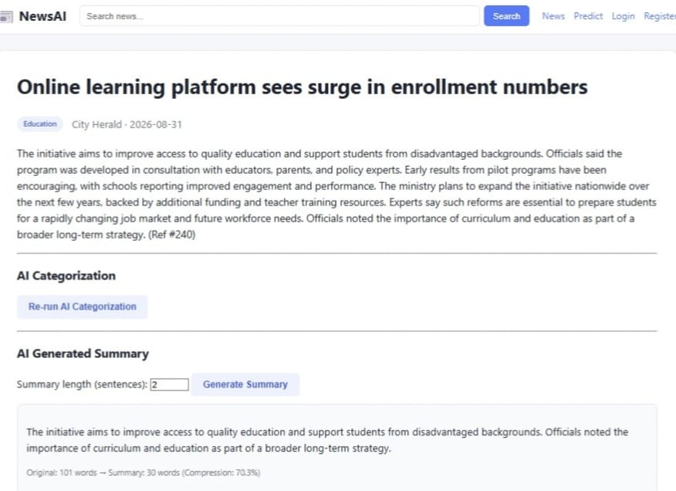
OUTPUT

Slide 18
MODULE 4
Multilingual Translation System
FUNCTIONS
1
Accepts the categorized article or generated summary as input
PURPOSE
2
Allows the user to select a preferred language
To translate news articles and summaries into different languages according to the user's preference.
3
Processes the text using an AI-based translation model or service
4
Translates news into languages such as English, Tamil, Telugu, and Hindi
5
Preserves the important meaning and context of the original content
6
Displays the translated article or summary to the user
10

Slide 19
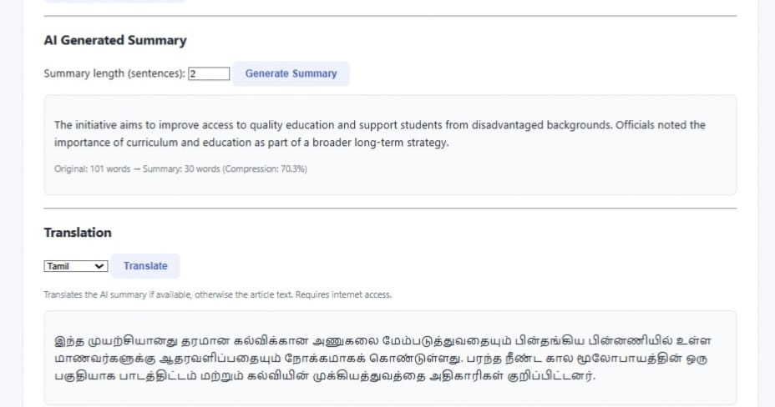
OUTPUT

Slide 20
MODULE 5
Personalized News Recommendation System
FUNCTIONS
1
Collects user preferences and selected news categories
PURPOSE
To recommend relevant news based on the user's interests, preferences, and reading behavior.
Analyzes the user's reading history and interaction with articles
2
3
Identifies topics that are frequently viewed or preferred
4
Matches user interests with available categorized news
5
Ranks relevant articles using a recommendation algorithm
6
Displays a personalized news feed containing suitable articles
11

Slide 21
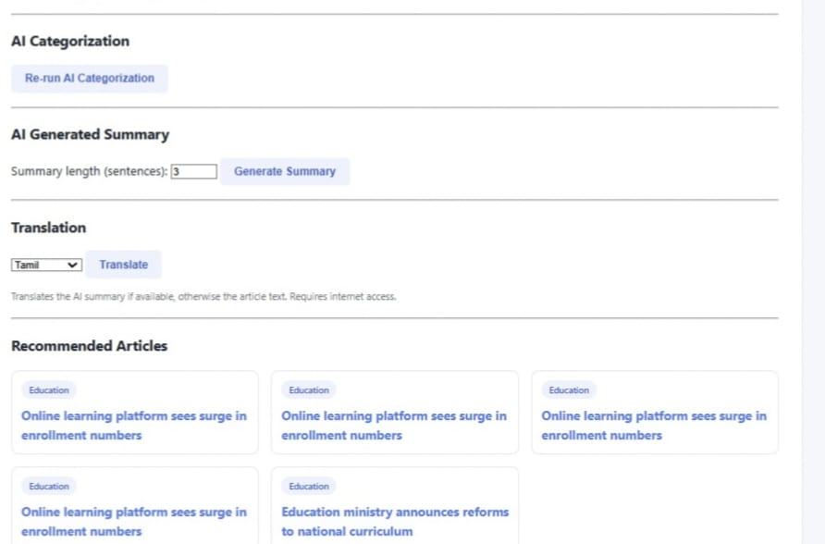
OUTPUT

Slide 22
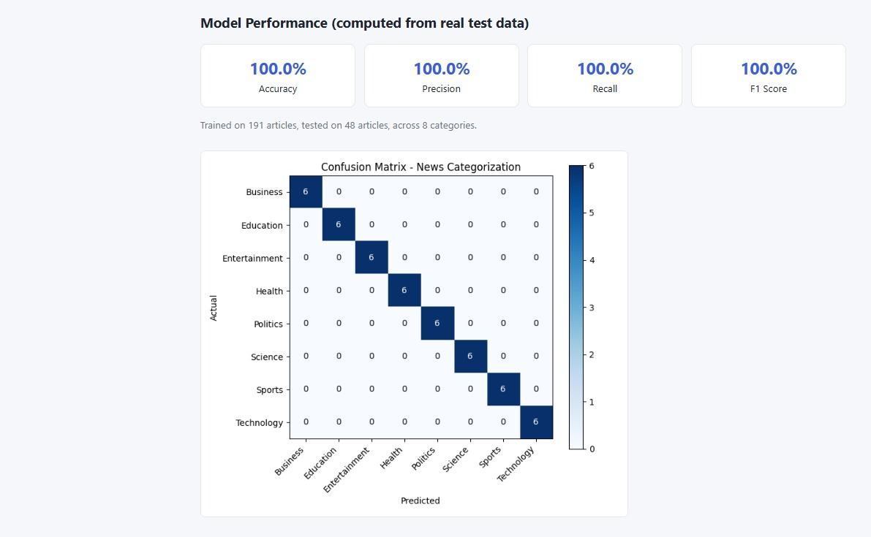
OUTPUT

Slide 23
Results & Discussion
Successful News Collection: News articles were collected and pre-processed to remove duplicate, irrelevant, and noisy content.
Accurate News Categorization: The system classified articles into categories such as Politics, Sports, Technology, Business, and Entertainment.
Effective Summarization: The summarization module generated concise summaries, reducing the time required to read lengthy news articles.
Multilingual Accessibility: News articles and summaries could be translated into multiple languages, making the system accessible to a wider range of users.
Personalized Recommendations: The recommendation module identified user interests and provided relevant news based on categories and reading preferences.
Integrated News Platform: The combined system provided categorized, summarized, multilingual, and personalized news through a single platform, improving overall user experience.

Slide 24
ADVANTAGES & APPLICATIONS
Advantages
Automated News Processing – Reduces manual effort in collecting and organizing news.
Faster Information Access – Summaries help users understand lengthy articles quickly.
Accurate Categorization – Automatically organizes news into relevant topics.
Multilingual Support – Makes news accessible in different languages.
Personalized Experience – Recommends news according to user interests.
User-Friendly Platform – Provides multiple news services in one integrated system.
Applications
News Websites & Applications – Automated categorization, summarization, and recommendations.
Digital Media Platforms – Personalized news feeds for users.
Educational Platforms – Provides simplified news for students and learners.
Multilingual News Services – Delivers news in regional and international languages.
News Monitoring Systems – Helps organizations track news related to specific topics.
Smart Information Assistants – Can be integrated with AI chatbots and voice assistants.

Slide 25
FUTURE SCOPE
Fake News Detection – Identify misleading or unreliable news automatically.
Real-Time News Processing – Process breaking news as soon as it is published.
Voice-Based News – Allow users to listen to summarized news.
More Indian Languages – Extend support to additional regional languages.
Advanced Personalization – Use user behavior and context for smarter recommendations.
Sentiment & Trend Analysis – Analyze public sentiment and identify trending topics.

Slide 26
CONCLUSION
Provides an intelligent solution for processing large amounts of online news
Multilingual translation makes news accessible across language preferences
✓
✓
Automatically collects, cleans, and categorizes news using AI and NLP techniques
The recommendation module personalizes news based on interests and behavior
✓
✓
The summarization module helps users understand lengthy news in less time
Overall, NewsAI makes news organized, accessible, concise, multilingual, and personalized
✓
✓
12

Slide 27
REFERENCES
Kumar, C. S., & Swamy, L. N. (2025, September). EchoNews: An AI-Powered RSS Aggregation and Summarization System for Personalized News Delivery. In 2025 2nd Asia Pacific Conference on Innovation in Technology (APCIT) (pp. 1-5). IEEE.
Kumar, S. (2024). The role of artificial intelligence in shaping news narratives: A review of global case studies. Journal of Informatics Education and Research, 4(3).
Kumar, A. S., Venu, R., Vani, K., & Pratixith, A. (2025, November). AI Powered Chatbot Using NLP. In International Conference on Computer Science and Communication Engineering (ICCSCE 2025) (pp. 1320-1331). Atlantis Press.
Song, Z. X., Cheung, K. W., & Jia, Z. Y. (2026). Transforming Historical Newspaper Research and Preservation Through AI: A Global Perspective. Journalism and Media, 7(1), 10.
Mahlil, M., Abdi, M. I., & Safriadi, S. (2026). Artificial Intelligence in News Translation: A Systematic Literature Review. Journal of Language Testing and Studies, 2(1), 39-56.

Slide 28
THANK YOU!!!

